Slide 1
Quest Screen Designs
V1.0

Slide 2
QUEST
Login
Password
marcus.poulton
*******
GO

Slide 3
QUEST
MAP GAZ SBP
PERF DMP COV
HELD ROUTE INC
TELE REST RES

Slide 4
QUEST
MAP GAZ SBP
PERF DMP COV
HELD ROUTE INC
TELE REST RES

Slide 5
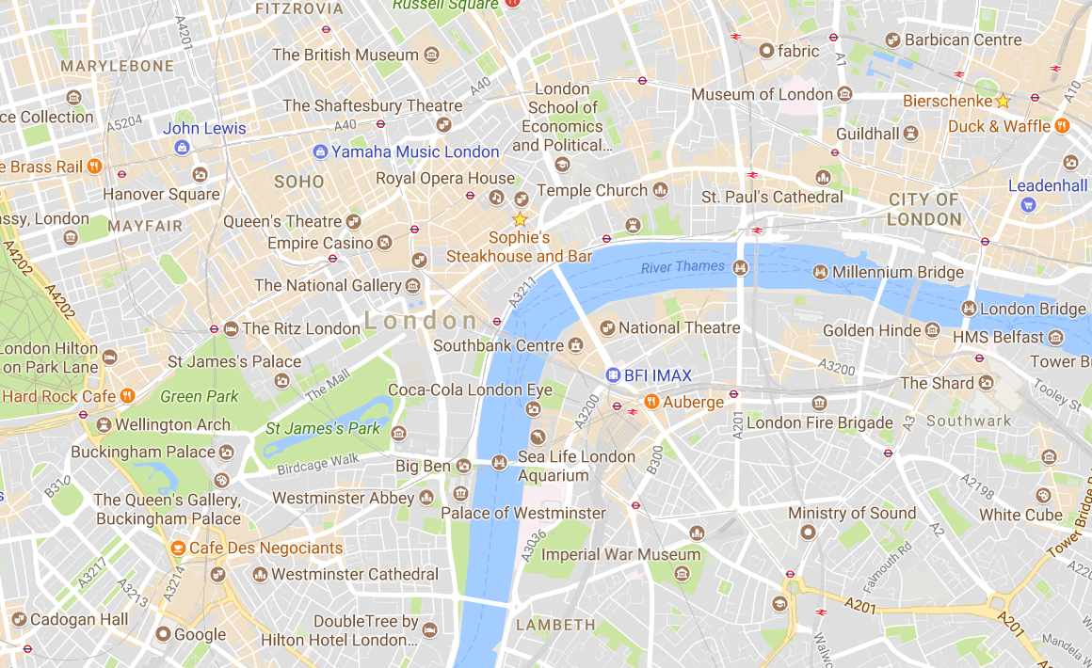
MAP
AEU-C
AEU
FRU-C
FRU
COM-C
C1
HOLES
C2
INC-C
C3
C4
+
_
LOCK
CCG
AZ
SBP
ROAD
SAT
OUTL

Slide 6
MAP
AEU-C
AEU
FRU-C
FRU
COM-C
C1
HOLES
C2
INC-C
C3
C4
+
_
LOCK
CCG
AZ
SBP
ROAD
SAT
OUTL

Slide 7
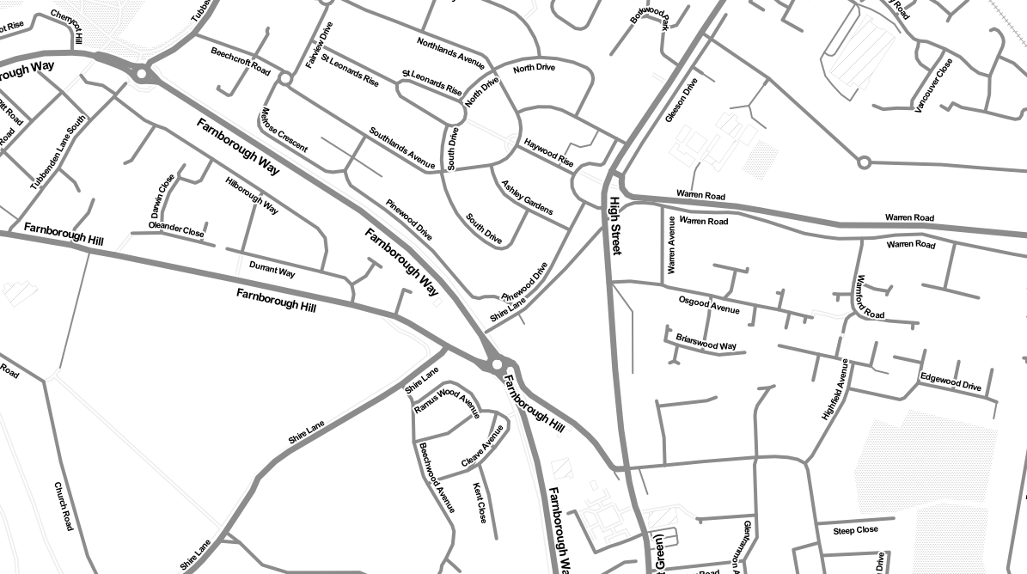
MAP
AEU-C
AEU
FRU-C
FRU
COM-C
C1
HOLES
C2
INC-C
C3
C4
+
_
LOCK
CCG
AZ
SBP
ROAD
SAT
OUTL

Slide 8
MAP
AEU-C
AEU
FRU-C
FRU
COM-C
C1
HOLES
C2
INC-C
C3
C4
+
_
LOCK
CCG
AZ
SBP
ROAD
SAT
OUTL

Slide 9

MAP
AEU-C
AEU
MAP GAZ AAC
PERF DMP COV
HELD ROUTE INC
TELE REST RES
FRU-C
FRU
COM-C
C1
HOLES
C2
INC-C
C3
C4
+
_
LOCK
CCG
AZ
SBP
ROAD
SAT
OUTL

Slide 10

MAP
AEU-C
AEU
MAP GAZ AAC
PERF DMP COV
HELD ROUTE INC
TELE REST RES
FRU-C
FRU
COM-C
C1
HOLES
C2
INC-C
C3
C4
+
_
LOCK
CCG
AZ
SBP
ROAD
SAT
OUTL

Slide 11
MAP
GAZ
search
AEU-C
AEU
FRU-C
FRU
COM-C
C1
HOLES
C2
INC-C
C3
FUZZ
EXACT
NEAR
COORD
C4
+
_
LOCK
CCG
AZ
SBP
ROAD
SAT
OUTL

Slide 12
MAP
GAZ
search
BR6 6EF
AEU-C
AEU
2 HIGH BEECHES, ORPINGTON , BR6 6EF
4 HIGH BEECHES, ORPINGTON , BR6 6EF
6 HIGH BEECHES, ORPINGTON , BR6 6EF
8 HIGH BEECHES, ORPINGTON , BR6 6EF
10 HIGH BEECHES, ORPINGTON , BR6 6EF
12 HIGH BEECHES, ORPINGTON , BR6 6EF
14 HIGH BEECHES, ORPINGTON , BR6 6EF
FRU-C
FRU
COM-C
C1
HOLES
C2
INC-C
C3
FUZZ
EXACT
NEAR
COORD
C4
+
_
LOCK
CCG
AZ
SBP
ROAD
SAT
OUTL

Slide 13
MAP
GAZ
search
BR6 6EF
AEU-C
AEU
2 HIGH BEECHES, ORPINGTON , BR6 6EF
4 HIGH BEECHES, ORPINGTON , BR6 6EF
6 HIGH BEECHES, ORPINGTON , BR6 6EF
8 HIGH BEECHES, ORPINGTON , BR6 6EF
10 HIGH BEECHES, ORPINGTON , BR6 6EF
12 HIGH BEECHES, ORPINGTON , BR6 6EF
14 HIGH BEECHES, ORPINGTON , BR6 6EF
FRU-C
FRU
COM-C
C1
HOLES
C2
INC-C
C3
FUZZ
EXACT
NEAR
COORD
C4
+
_
LOCK
CCG
AZ
SBP
ROAD
SAT
OUTL

Slide 14
MAP
GAZ
search
BR6 6EF
AEU-C
AEU
2 HIGH BEECHES, ORPINGTON , BR6 6EF
4 HIGH BEECHES, ORPINGTON , BR6 6EF
6 HIGH BEECHES, ORPINGTON , BR6 6EF
8 HIGH BEECHES, ORPINGTON , BR6 6EF
10 HIGH BEECHES, ORPINGTON , BR6 6EF
12 HIGH BEECHES, ORPINGTON , BR6 6EF
14 HIGH BEECHES, ORPINGTON , BR6 6EF
16 HIGH BEECHES, ORPINGTON , BR6 6EF
18 HIGH BEECHES, ORPINGTON , BR6 6EF
20 HIGH BEECHES, ORPINGTON , BR6 6EF
22 HIGH BEECHES, ORPINGTON , BR6 6EF
24 HIGH BEECHES, ORPINGTON , BR6 6EF
26 HIGH BEECHES, ORPINGTON , BR6 6EF
28 HIGH BEECHES, ORPINGTON , BR6 6EF
30 HIGH BEECHES, ORPINGTON , BR6 6EF
32 HIGH BEECHES, ORPINGTON , BR6 6EF
34 HIGH BEECHES, ORPINGTON , BR6 6EF
36 HIGH BEECHES, ORPINGTON , BR6 6EF
38 HIGH BEECHES, ORPINGTON , BR6 6EF
FRU-C
FRU
COM-C
C1
HOLES
C2
INC-C
C3
C4
+
_
LOCK
CCG
AZ
SBP
ROAD
SAT
OUTL
FUZZ
EXACT
NEAR
COORD

Slide 15
MAP
GAZ
search
BR6 6EF
AEU-C
AEU
2 HIGH BEECHES, ORPINGTON , BR6 6EF
4 HIGH BEECHES, ORPINGTON , BR6 6EF
6 HIGH BEECHES, ORPINGTON , BR6 6EF
8 HIGH BEECHES, ORPINGTON , BR6 6EF
10 HIGH BEECHES, ORPINGTON , BR6 6EF
12 HIGH BEECHES, ORPINGTON , BR6 6EF
14 HIGH BEECHES, ORPINGTON , BR6 6EF
16 HIGH BEECHES, ORPINGTON , BR6 6EF
18 HIGH BEECHES, ORPINGTON , BR6 6EF
20 HIGH BEECHES, ORPINGTON , BR6 6EF
22 HIGH BEECHES, ORPINGTON , BR6 6EF
24 HIGH BEECHES, ORPINGTON , BR6 6EF
26 HIGH BEECHES, ORPINGTON , BR6 6EF
28 HIGH BEECHES, ORPINGTON , BR6 6EF
30 HIGH BEECHES, ORPINGTON , BR6 6EF
32 HIGH BEECHES, ORPINGTON , BR6 6EF
34 HIGH BEECHES, ORPINGTON , BR6 6EF
36 HIGH BEECHES, ORPINGTON , BR6 6EF
38 HIGH BEECHES, ORPINGTON , BR6 6EF
FRU-C
FRU
COM-C
C1
HOLES
C2
INC-C
C3
C4
+
_
LOCK
CCG
AZ
SBP
ROAD
SAT
OUTL
FUZZ
EXACT
NEAR
COORD

Slide 16
MAP
GAZ
search
BR6 6EF
AEU-C
AEU
2 HIGH BEECHES, ORPINGTON , BR6 6EF
4 HIGH BEECHES, ORPINGTON , BR6 6EF
6 HIGH BEECHES, ORPINGTON , BR6 6EF
8 HIGH BEECHES, ORPINGTON , BR6 6EF
10 HIGH BEECHES, ORPINGTON , BR6 6EF
12 HIGH BEECHES, ORPINGTON , BR6 6EF
14 HIGH BEECHES, ORPINGTON , BR6 6EF
FRU-C
FRU
COM-C
C1
HOLES
C2
INC-C
C3
FUZZ
EXACT
NEAR
COORD
C4
+
_
LOCK
CCG
AZ
SBP
ROAD
SAT
OUTL

Slide 17
MAP
GAZ
search
BR6 6EF
AEU-C
AEU
2 HIGH BEECHES, ORPINGTON , BR6 6EF
4 HIGH BEECHES, ORPINGTON , BR6 6EF
6 HIGH BEECHES, ORPINGTON , BR6 6EF
8 HIGH BEECHES, ORPINGTON , BR6 6EF
10 HIGH BEECHES, ORPINGTON , BR6 6EF
12 HIGH BEECHES, ORPINGTON , BR6 6EF
14 HIGH BEECHES, ORPINGTON , BR6 6EF
FRU-C
FRU
COM-C
C1
HOLES
C2
INC-C
C3
FUZZ
EXACT
NEAR
COORD
C4
+
MAP GAZ AAC
PERF DMP COV
HELD ROUTE INC
TELE REST RES
_
LOCK
CCG
AZ
SBP
ROAD
SAT
OUTL

Slide 18
GAZ
MAP
GAZ
search
BR6 6EF
AEU-C
AEU
2 HIGH BEECHES, ORPINGTON , BR6 6EF
4 HIGH BEECHES, ORPINGTON , BR6 6EF
6 HIGH BEECHES, ORPINGTON , BR6 6EF
8 HIGH BEECHES, ORPINGTON , BR6 6EF
10 HIGH BEECHES, ORPINGTON , BR6 6EF
12 HIGH BEECHES, ORPINGTON , BR6 6EF
14 HIGH BEECHES, ORPINGTON , BR6 6EF
FRU-C
FRU
COM-C
C1
HOLES
C2
INC-C
C3
FUZZ
EXACT
NEAR
COORD
C4
+
MAP GAZ AAC
PERF DMP COV
HELD ROUTE INC
TELE REST RES
_
LOCK
CCG
AZ
SBP
ROAD
SAT
OUTL

Slide 19
GAZ
MAP
GAZ
search
search
BR6 6EF
AEU-C
AEU
2 HIGH BEECHES, ORPINGTON , BR6 6EF
4 HIGH BEECHES, ORPINGTON , BR6 6EF
6 HIGH BEECHES, ORPINGTON , BR6 6EF
8 HIGH BEECHES, ORPINGTON , BR6 6EF
10 HIGH BEECHES, ORPINGTON , BR6 6EF
12 HIGH BEECHES, ORPINGTON , BR6 6EF
14 HIGH BEECHES, ORPINGTON , BR6 6EF
FRU-C
FRU
COM-C
C1
HOLES
C2
INC-C
C3
FUZZ
EXACT
NEAR
COORD
C4
TEL
EXT.
CLI
EISEC
ADDRESS
STARTED
DURATION
31
07525626059
519654 152612 (AML PENDING)
NONE
12:23 23 SEP 2017
3:23
+
_
LOCK
CCG
AZ
SBP
ROAD
SAT
OUTL
ELLIPSE
GAZ
EXT

Slide 20
GAZ
MAP
GAZ
search
search
BR6 6EF
AEU-C
AEU
2 HIGH BEECHES, ORPINGTON , BR6 6EF
4 HIGH BEECHES, ORPINGTON , BR6 6EF
6 HIGH BEECHES, ORPINGTON , BR6 6EF
8 HIGH BEECHES, ORPINGTON , BR6 6EF
10 HIGH BEECHES, ORPINGTON , BR6 6EF
12 HIGH BEECHES, ORPINGTON , BR6 6EF
14 HIGH BEECHES, ORPINGTON , BR6 6EF
FRU-C
FRU
COM-C
C1
HOLES
C2
INC-C
C3
FUZZ
EXACT
NEAR
COORD
C4
TEL
EXT.
CLI
EISEC
ADDRESS
STARTED
DURATION
31
07525626059
519654 152612 (AML PENDING)
NONE
12:23 23 SEP 2017
3:23
+
_
LOCK
CCG
AZ
SBP
ROAD
SAT
OUTL
ELLIPSE
GAZ
EXT

Slide 21
MAP
GAZ
search
BR6 6EF
AEU
2 HIGH BEECHES, ORPINGTON , BR6 6EF
4 HIGH BEECHES, ORPINGTON , BR6 6EF
6 HIGH BEECHES, ORPINGTON , BR6 6EF
8 HIGH BEECHES, ORPINGTON , BR6 6EF
10 HIGH BEECHES, ORPINGTON , BR6 6EF
12 HIGH BEECHES, ORPINGTON , BR6 6EF
14 HIGH BEECHES, ORPINGTON , BR6 6EF
16 HIGH BEECHES, ORPINGTON , BR6 6EF
18 HIGH BEECHES, ORPINGTON , BR6 6EF
20 HIGH BEECHES, ORPINGTON , BR6 6EF
22 HIGH BEECHES, ORPINGTON , BR6 6EF
24 HIGH BEECHES, ORPINGTON , BR6 6EF
26 HIGH BEECHES, ORPINGTON , BR6 6EF
28 HIGH BEECHES, ORPINGTON , BR6 6EF
30 HIGH BEECHES, ORPINGTON , BR6 6EF
32 HIGH BEECHES, ORPINGTON , BR6 6EF
AEU-C
FRU-C
FRU
COM-C
C1
HOLES
INC-C
C2
+
C3
_
C4
LOCK
CCG
AZ
SBP
ROAD
SAT
OUTL
FUZZ
EXACT
NEAR
COORD
TEL
EXT.
CLI
EISEC
ADDRESS
STARTED
DURATION
AAC
31
07525626059
519654 152612
(AML PENDING)
NONE
12:23 23 SEP 2017
3:23
MAP GAZ AAC
PERF DMP COV
HELD ROUTE INC
TELE REST RES
ELLIPSE
GAZ
EXT
ACTIONS
BEST

Slide 22
GAZ
MAP
GAZ
search
search
BR6 6EF
AEU-C
AEU
2 HIGH BEECHES, ORPINGTON , BR6 6EF
4 HIGH BEECHES, ORPINGTON , BR6 6EF
6 HIGH BEECHES, ORPINGTON , BR6 6EF
8 HIGH BEECHES, ORPINGTON , BR6 6EF
10 HIGH BEECHES, ORPINGTON , BR6 6EF
12 HIGH BEECHES, ORPINGTON , BR6 6EF
14 HIGH BEECHES, ORPINGTON , BR6 6EF
FRU-C
FRU
COM-C
C1
HOLES
C2
INC-C
C3
FUZZ
EXACT
NEAR
COORD
C4
+
MAP GAZ AAC
PERF DMP COV
HELD ROUTE INC
TELE REST RES
_
LOCK
CCG
AZ
SBP
ROAD
SAT
OUTL

Slide 23
GAZ
GAZ
MAP
GAZ
search
BR6 6EF
AEU-C
AEU
2 HIGH BEECHES, ORPINGTON , BR6 6EF
4 HIGH BEECHES, ORPINGTON , BR6 6EF
6 HIGH BEECHES, ORPINGTON , BR6 6EF
8 HIGH BEECHES, ORPINGTON , BR6 6EF
10 HIGH BEECHES, ORPINGTON , BR6 6EF
12 HIGH BEECHES, ORPINGTON , BR6 6EF
14 HIGH BEECHES, ORPINGTON , BR6 6EF
FRU-C
FRU
COM-C
C1
HOLES
C2
INC-C
C3
FUZZ
EXACT
NEAR
COORD
C4
AAC-1
+
SUGGEST
CURRENT
Move A102 → SBP32
(improves Coverage)
A258 → SBP28 ETA: 12:34
C152 → SBP12 ETA: 12:34 OVD
_
LOCK
CCG
AZ
SBP
ROAD
SAT
OUTL
ACTIONS
BEST

Slide 24
GAZ
GAZ
MAP
GAZ
search
BR6 6EF
AEU-C
AEU
2 HIGH BEECHES, ORPINGTON , BR6 6EF
4 HIGH BEECHES, ORPINGTON , BR6 6EF
6 HIGH BEECHES, ORPINGTON , BR6 6EF
8 HIGH BEECHES, ORPINGTON , BR6 6EF
10 HIGH BEECHES, ORPINGTON , BR6 6EF
12 HIGH BEECHES, ORPINGTON , BR6 6EF
14 HIGH BEECHES, ORPINGTON , BR6 6EF
FRU-C
FRU
COM-C
C1
HOLES
C2
INC-C
C3
FUZZ
EXACT
NEAR
COORD
C4
AAC-2
+
_
LOCK
CCG
AZ
SBP
ROAD
SAT
OUTL
ACTIONS
BEST

Slide 25
GAZ
GAZ
MAP
GAZ
search
BR6 6EF
AEU-C
AEU
2 HIGH BEECHES, ORPINGTON , BR6 6EF
4 HIGH BEECHES, ORPINGTON , BR6 6EF
6 HIGH BEECHES, ORPINGTON , BR6 6EF
8 HIGH BEECHES, ORPINGTON , BR6 6EF
10 HIGH BEECHES, ORPINGTON , BR6 6EF
12 HIGH BEECHES, ORPINGTON , BR6 6EF
14 HIGH BEECHES, ORPINGTON , BR6 6EF
FRU-C
FRU
COM-C
C1
HOLES
C2
INC-C
C3
FUZZ
EXACT
NEAR
COORD
C4
AAC-2
+
_
LOCK
CCG
AZ
SBP
ROAD
SAT
OUTL
ACTIONS
BEST

Slide 26
PLG1
Name of plugin
Full screen mode
unselected
OfBTN
OnBTN
selected
3-screen mode

Slide 27
PLG1
PLG2
Name of plugin
Name of plugin
Expand down
Swap with main
3-screen mode
unselected
PLG3
Name of plugin
Expand up
OfBTN
Main Full screen
OnBTN
selected
3-screen mode
Swap with main

Slide 28
PLG1
PLG2
Name of plugin
Name of plugin
2-screen mode
unselected
OfBTN
Main Full screen
Expand down
OnBTN
selected
3-screen mode
Swap with main

